Slide 1
Sales Data Analysis
This project is based on a sample sales dataset originally created for sales simulation and retail analytics training. The dataset includes detailed order information, sales figures, customer details, shipping data, and product information. It is widely used for segmentation, customer analytics, clustering, and other business intelligence activities. For this project, the dataset was utilized to design a comprehensive sales performance dashboard in Microsoft Excel, focusing on revenue tracking, growth analysis, deal size, top-performing products and cities, and order status distribution.
--by Priya Rajurkar

Slide 2
Project Overview
The project began with data cleaning and preparation, which included fixing inconsistent date formats, standardizing phone numbers, merging address fields, and handling blank values. Calculated fields such as revenue, growth rate, and average deal size were created to support further analysis. Pivot Tables were used to group and summarize data by month, city, country, product, and deal size. Various charts, including bar, line, pie, and donut charts, were incorporated to visualize insights such as monthly growth trends, sales distribution, and order status. KPI cards were designed to highlight key metrics like Total Revenue, Total Orders, Average Deal Size, and Growth Rate. Additionally, dynamic elements like a scroll bar with the OFFSET formula were implemented to view top customers interactively.

Slide 3
Technologies Used
The dashboard was built using Microsoft Excel for both data cleaning and visualization. Various Excel formulas such as IF, DATE, SUBSTITUTE, TEXTJOIN, INDEX-MATCH, and OFFSET were used to prepare and process the data. Pivot Tables and Slicers were used to summarize and filter the data, while different charts such as bar charts, line charts, pie charts, and donut charts were used to visualize key insights. KPI cards were created using linked text boxes, conditional formatting, and custom number formats.

Slide 4
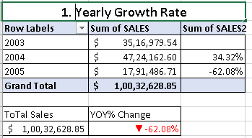

KPI’s

Slide 5
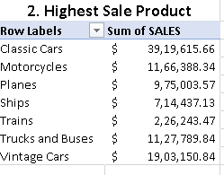



Slide 6
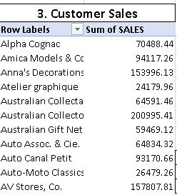







Slide 7
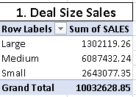
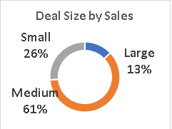
Charts

Slide 8
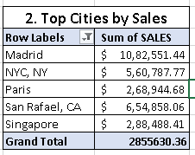
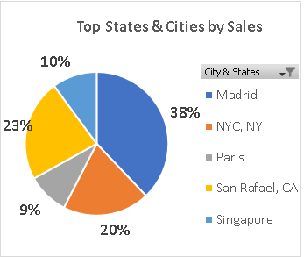

Slide 9
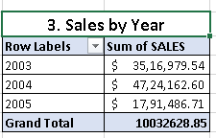
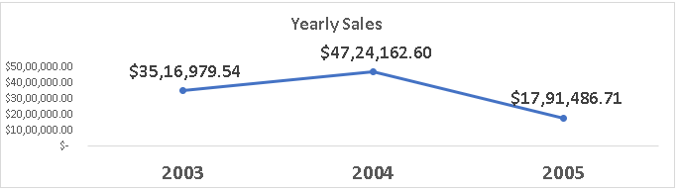

Slide 10
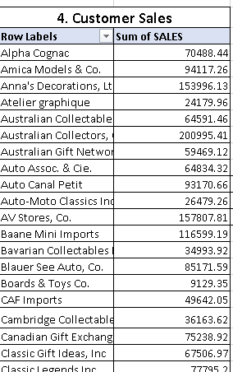
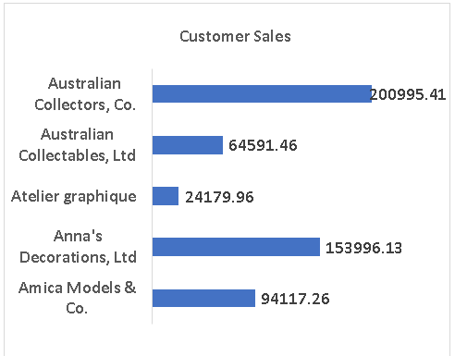

Slide 11
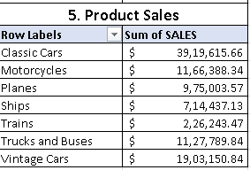
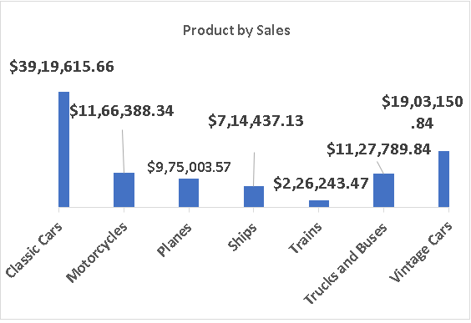

Slide 12
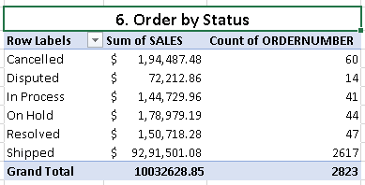
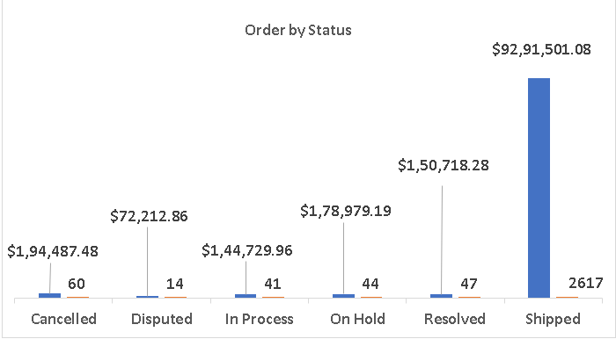

Slide 13
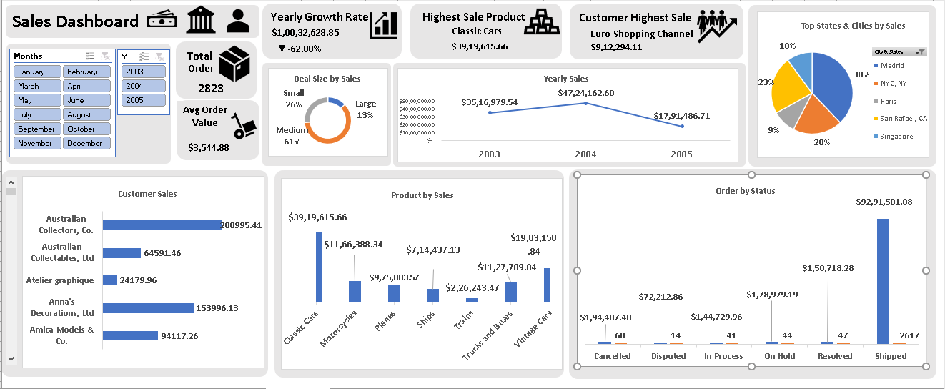
Dashboard

Slide 14
Summary
The final dashboard provides a complete and interactive view of sales performance using Microsoft Excel. It combines data cleaning, calculated metrics, Pivot Tables, KPI cards, and multiple charts to deliver actionable insights. The dashboard highlights revenue trends, top-performing products and cities, and the distribution of orders by status. This project demonstrates strong skills in Excel-based analytics and dashboard design while showcasing how sample retail datasets can be transformed into meaningful business intelligence tools.

Slide 15
Thank you

